Slide 1
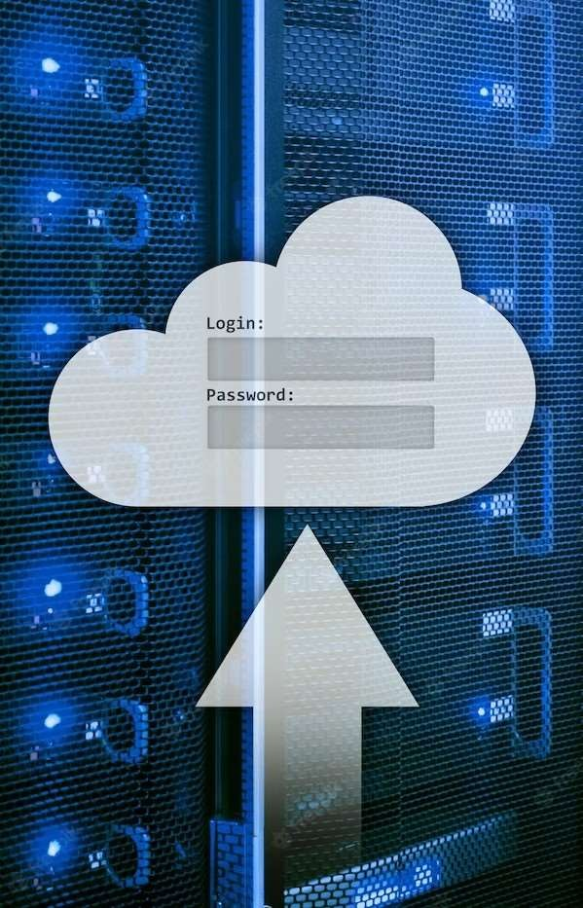
An Introduction to Java, MySǪL, and JDBC

Slide 2
Presented by: 1) Ayush Bhoyar 2) Jaywant Avhad 3) Radha Bhutada 4) Chirayu Borse 5)Onkar Bhojane DEPARTMENT OF MULTIDISCIPLINARY ENGINEERING (DOME) VISHWAKARMA INSTITUTE OF TECHNOLOGY ,PUNE

Slide 3

Introduction
Java JDBC allows Java code to interact with MySQL database. It provides a bridge between the two, enabling seamless communication and data
manipulation. JDBC is an integral part of Java's database connectivity, offering a standard APIfor accessing various database systems. This presentation will explore the key concepts and functionalities of Java JDBC.

Slide 4
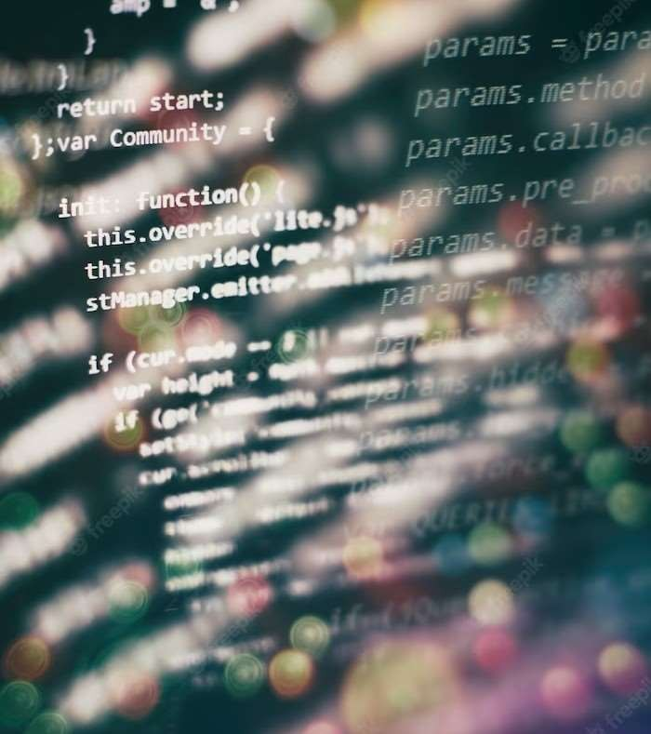
What is Java?
Java is a widely-used object- oriented programming language known for its platform independence and robustness.
It provides a powerful fram ework for building applications that can run on any device or operating system. With its extensive libraries and community support, Java has become a popular choice for developing enterprise-level software solutions.

Slide 5
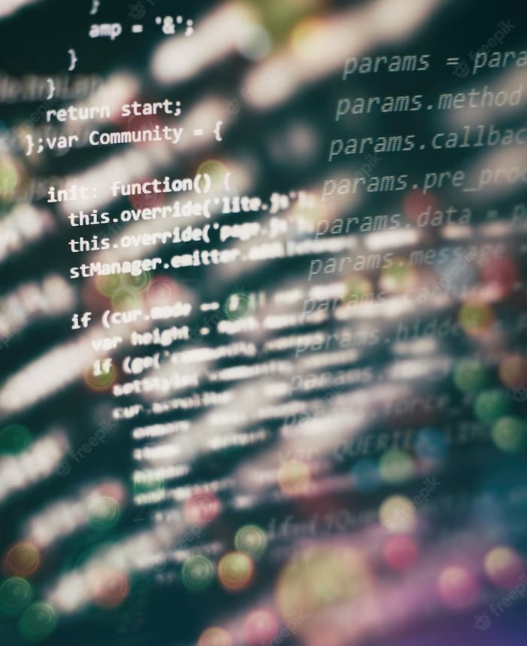
Installing Java
Installing Java is a fundamental step in the installation process. We will guide you through the installation steps for different operating systems, including Windows, macOS, and Linux.
Additionally, we will cover important considerations such as selecting the correct version and conﬁguring
environment variables.

Slide 6

What is MySQL?
MySQL is an open-source relational database management system (RDBMS) that allows users to store, manage, and manipulate large amounts
of data efﬁciently. It provides a reliable and scalable solution for data storage and retrieval.
MySQL is widely used in various applications
ranging from small web applications to large- scale enterprise systems.

Slide 7

Installing MySQL
Once Java is successfully installed, we can proceed with the installation of MySQL. This slide will cover the installation steps for various platforms, including Windows, macOS, and Linux. We will also discuss important aspects such as setting up the root password and conﬁguring security settings.

Slide 8
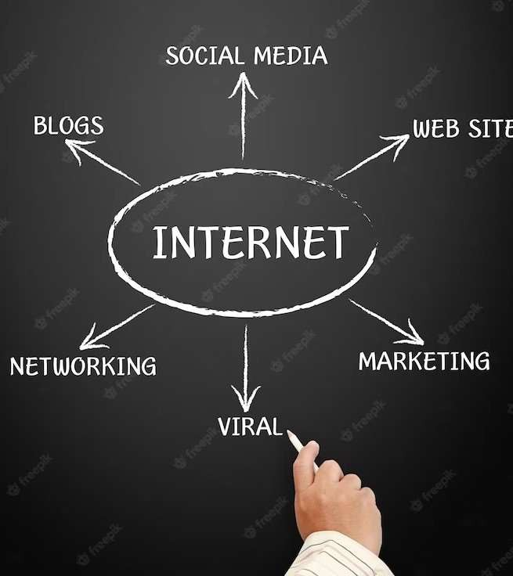
JDBC
JDBC (Java Database Connectivity) is a Java API that provides a standard way of accessing relational databases. It enables Java applications to interact with databases like M ySQL and perform operations such as querying, inserting, updating, and deleting data. JDBC acts as a bridge between Java and the database, allowing seamless integration and efﬁcient data manipulation.

Slide 9

Establishing Database Connection
To establish a connection between Java code and M ySQL database using JDBC, developers need to provide database URL, username & password.
The JDBC driver manager handles the connection establishm ent and provides a connection object for executing queries. The connection remains active until explicitly closed, allowing multiple operations during a session.

Slide 10
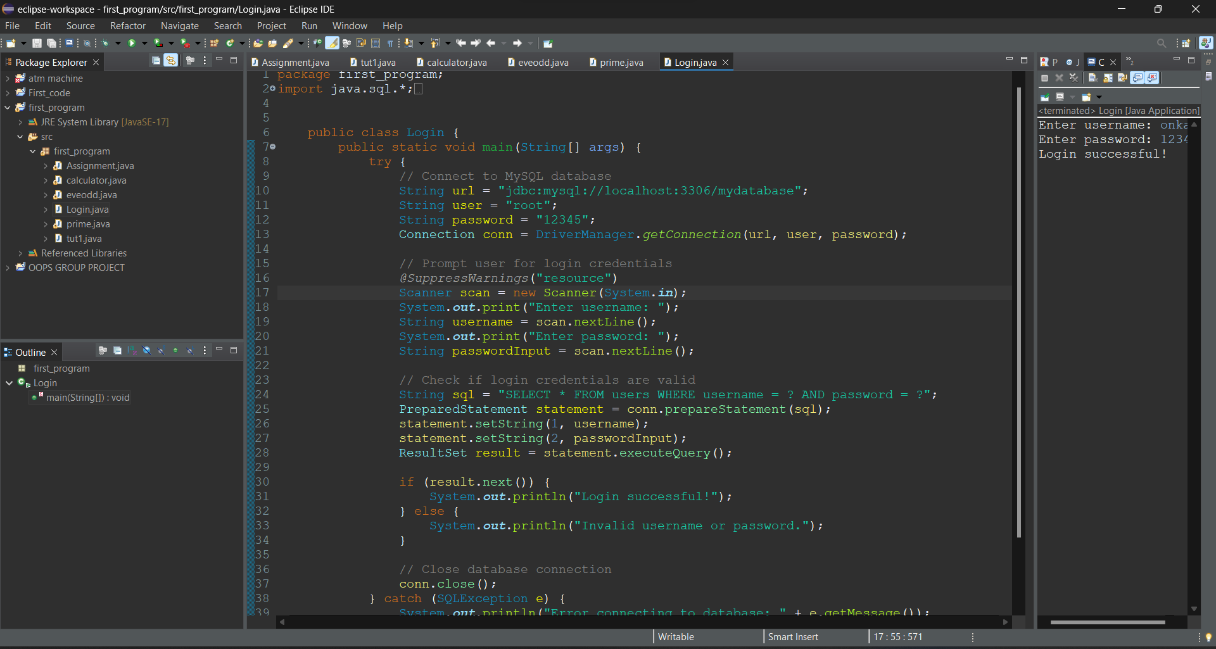

Slide 11
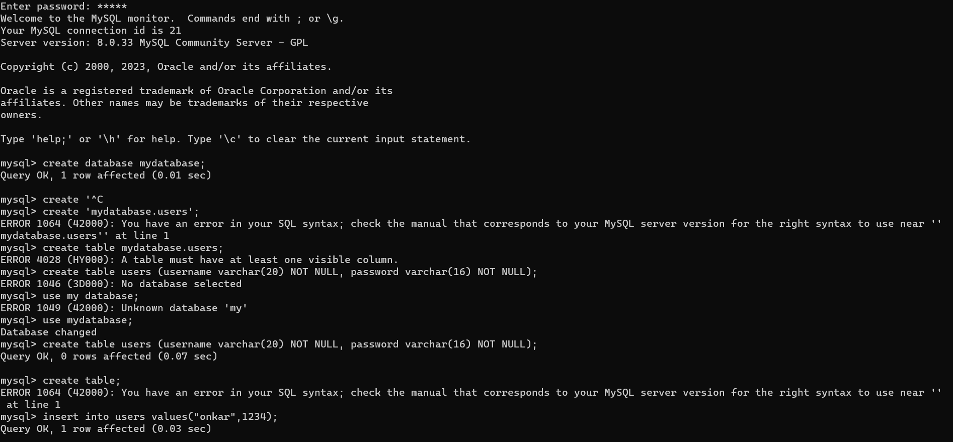
How to create Database by CMD ?

Slide 12
C onclusion
In conclusion, understanding the seamless integration of Java, MySQL, and JDBC is crucial for building robust and efﬁcient applications.
JDBC is a cross-platform API, so Java programs that use JDBC can be run on any operating system that supports Java.
JDBC is a powerful tool that can be used to develop a wide variety of Java applications that interact with databases. If you are a Java developer, you should learn how to use JDBC.

Slide 13
Thanks!

